Slide 1
BY: DANIEL DE PAZ
Gatsby / Headless CMS

Slide 2
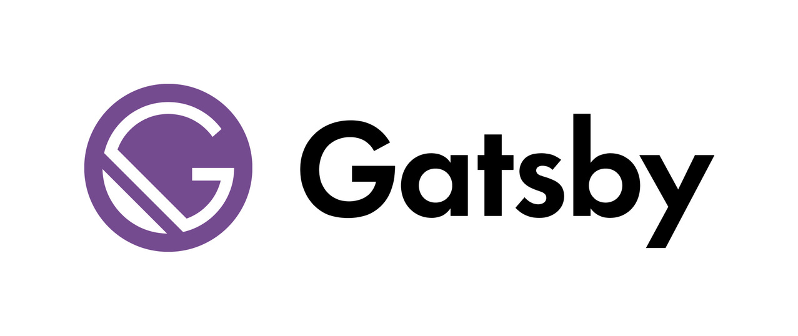
What is Gatsby?
It is and open-source Static Site Generator based on the JAM Stack, using ReactJS to create the templates, NodeJS for Server Side rendering and GraphQL for communication.
INTRODUCTION

Slide 3
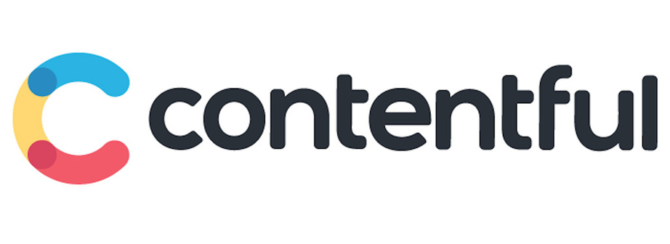
What is Contentful?
INTRODUCTION
Is a content infrastructure where you can create, manage and distribute content to any platform.

Slide 4
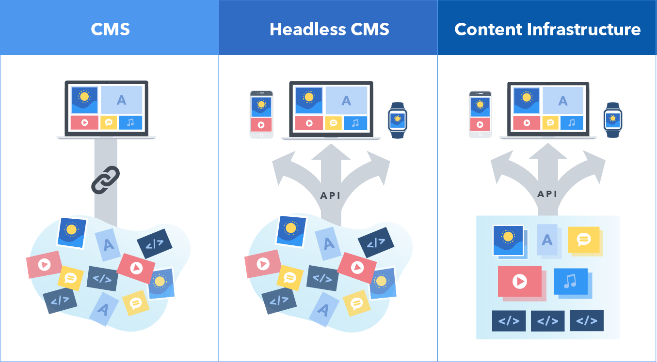
CMS and content infrastructure
A type of headless content management system.
It doesn’t take the traditional approach of organizing content around pages. Instead, it starts with a content model — a framework for organizing types of content and defining how each type relates to another.

Slide 5
Example

Slide 6
Thank you!
Have questions?
Slack
@DanielDePaz

